Slide 1
A2AProtocal
Agent2AgentProtocal
using
UV and Python

Slide 2
LLM ( Large Language Model )
LLM – Large Language Model
In simple words, it's a type of computer program that has been trained on a huge amount of text (like books, websites, and articles) so it can understand and generate human-like language.
Example
Business Example – Customer Support Chatbot
Company: An online shopping website like Amazon. Use of LLM: They use an LLM to power their chatbot.
Example Interaction:
Customer: "Where is my order?" LLM-powered Chatbot: "Hi! I see your order was shipped on May 1st and should arrive by May 5th. Would you like tracking details?"
Instead of hiring thousands of support agents, the company uses an LLM to answer most questions instantly.

Slide 3
AI Agents
An Agent is any software or system
Input -> Perceive ( Observe) environment
Process logic -> Decide what to do
Output or Action -> Act based on decision
Example
A robot vacuum is an AI agent. It senses dirt, maps your floor, and decides where to clean.

Slide 4
Agentic AI
More advanced, Autonomy-Focused
Advanced AI agents that act with greater autonomy, like:
Setting their own goals
Planning multi-step actions
Making decisions with minimal or no human input
These systems can reason, adapt, and even collaborate with other agents.
Example
A personal AI assistant that books travel for you:
It checks your calendar
Finds the best flights
Books hotels
Notifies you — all without asking at every step
That’s agentic behavior — it's not just reacting, it's taking initiative.

Slide 5
AI Agent Vs Agentic AI
AI Agent | Agentic AI
Reacts to input and makes decisions | Acts more like a human assistant: plans, reasons, adapts
Example Smart thermostat adjusting temperature | Example AI that manages your schedule, emails, and errands

Slide 6
Agentic AI Models / Frameworks
Framework | Description | Key Features
LangChain | A framework for building AI agents with LLMs | Tool use, memory, agent workflows, chains, integrations
Auto-GPT | Experimental open-source autonomous agent based on GPT | Self-directed goals, task breakdown, web interaction
BabyAGI | Minimalistic agent loop inspired by AGI thinking | Simple architecture, dynamic task prioritization
CrewAI | Multi-agent collaboration platform | Roles, memory, communication between agents
MetaGPT | Turns LLM into a multi-role software development team | Agent roles (PM, Engineer, QA), builds software

Slide 7
Agentic AI Models / Frameworks (Cont.…)
Framework | Description | Key Features
AgentVerse | Multi-agent simulation environment for agent behavior research | Focuses on agent collaboration in virtual environments
SuperAGI | Infrastructure for running autonomous agents with GUI | Vector memory, tool integrations, agent marketplace
AutoGen (Microsoft) | Framework for multi-agent conversations powered by LLMs | Conversational agents, code execution, reasoning tasks
Cognitive Architectures (e.g., ACT-R, SOAR) | Classical frameworks for cognitive agent modeling | Human-like reasoning and learning over time

Slide 8
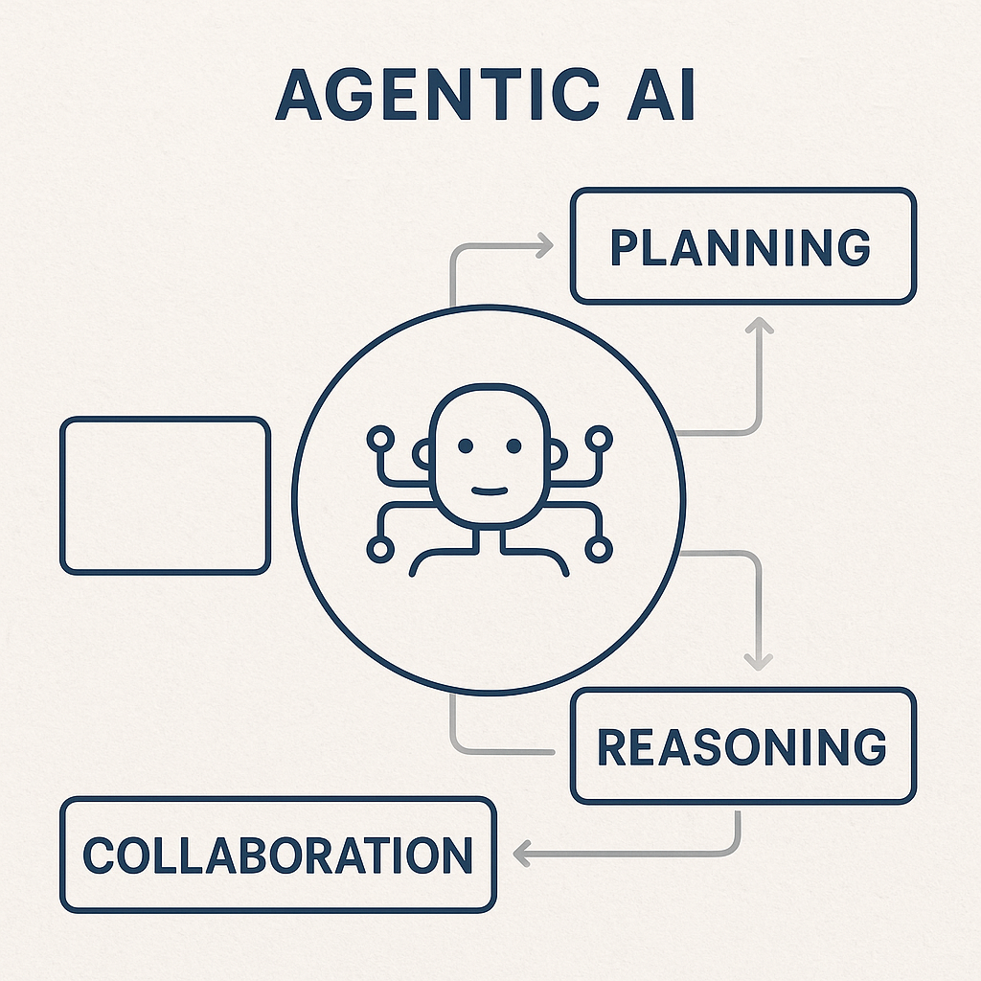
Agentic AI

Slide 9
Agentic AI
OpenAI Function-Calling Agents (via GPT-4)
GPT-4 can now act as an agent when paired with tools (e.g., API calls, memory).
Key trait: Responds intelligently and executes code or actions.
Use case: Virtual assistants, coding helpers, financial advisors.
BabyAGI
A lightweight task management AI agent.
Key trait: Continuously creates and prioritizes tasks based on a goal.
Use case: Project management, autonomous research agents.

Slide 10
Agentic AI (Cont.…)
Lang Chain Agents
A framework for building agentic applications using language models.
Key trait: Can choose tools, query APIs, interact with databases.
Use case: Multi-step workflows like booking travel or processing customer support tickets.
ReAct Agents (Reasoning + Acting)
A paper and model strategy where LLMs think step-by-step, then take actions.
Key trait: Combines reasoning with action loops.
Use case: Solving puzzles, answering complex queries, planning.
Auto-GPT
An open-source Python application built on GPT-4.
Key trait: Can create goals, break them into sub-tasks, use tools (like web search), and self-improve.
Use case: Researching and writing reports, automating workflows.

Slide 11
A2A Protocol
A2A stands for Agents-to-Agents communication
A modern approach where autonomous software agents communicate, collaborate, and make decisions without human intervention.
These agents can be:A2A stands decisions without human intervention.
These agents can be:
Bots
Microservices
AI Models
Autonomous Tools
Imagine a travel booking assistant
One agent checks flights ✈️ Another searches for hotels 🏨A third handles payment 💳
These agents communicate automatically using A2A protocols—coordinating in real time to complete the task.

Slide 12
A2A Protocol
Google A2A Portal
https://developers.googleblog.com/en/a2a-a-new-era-of-agent-interoperability/
https://google.github.io/A2A/
Git Hub
https://github.com/google/A2A

Slide 13
UV - Python
It is Fast Python package manager, similar to pip, developed by Astral .
It’s alternative to pip + virtualenv + pip-tools.
Important commands
Install UV
> uv python install
Run
> uv run .
> uv run main.py

